Slide 1
YAY GAME
Sorry no title yet

Slide 2
First things first
The game is:
Arcade
Endless Runner/Shooter
Most likely 2D

Slide 3
General flow of topic
Core Mechanics
Bonus Round Mechanics (and Layout)
Player details
Lives
Control
Powerup
Gun Based
Ammunition based w/ types of ammo
Time Based
Stat Based
Utility
Instant Use
Enemies
Types
Bonus Rounds
Bosses
Theme/Remarks

Slide 4
For the pictures/visualizations
Player – red circle
Enemy/Mook – blue circle with green outline
Boss – Giant Maroon Rectangle/Yellow Pentagon

Slide 5
Core Mechanics
Typical endless runner, with varying lengths of platforms, to make impressions of pitfalls, and possibly obstacles.
Score is determined by distance and (maybe) obstacles
Monsters appear randomly.
Monsters are considered obstacles
Killing a monster gives additional score and possibly p-ups
A bonus round of sorts will happen during the game randomly.(Shown in the game by the avatar simply slowing down until a full stop, and then a screen repositioning will occur.)

Slide 6
Bonus Round mechanics
Kill as much as you can:
Will spawn infinite monsters, kill as much without getting hit; A time limit will be implemented
Prizes are tiered; higher kill count, better powerup
Kill the boss(appears after the 4th bonus round):
A gigantic creature will appear, and you have to kill it within the time limit; if not killed, proceed as normal
Boss will not get movement, so no player frustrations
No attacks; should there be, ones that are easily avoidable(set pattern; avoidable at one platform, not the other)
Set rewards instead(longer invincibility/random powerup)

Slide 7
Boss Round
Should not fulfil time limit/get hit by attack, proceed as normal.
Same vulnerability style: hit in the head tummy or crotch, it will still deal the same amount of damage;
Weak-spot style: Head damage is greater than body damage (ala Monster Hunter)
Notes:
Weak spot style will make better use of the dual/tri platform system

Slide 8
Bonus Round Layout
Still the same layout?
Dual/Triple platforms?
Moving/Floating platforms? (No pitfalls)

Slide 9
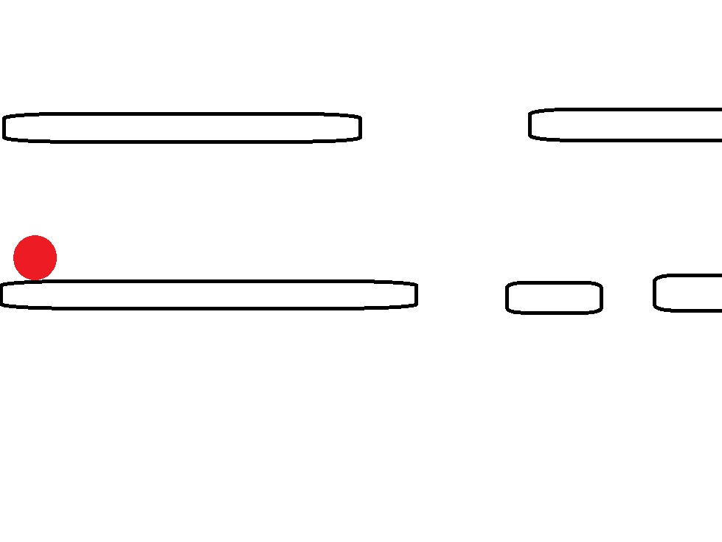
Dual Platform

Slide 10
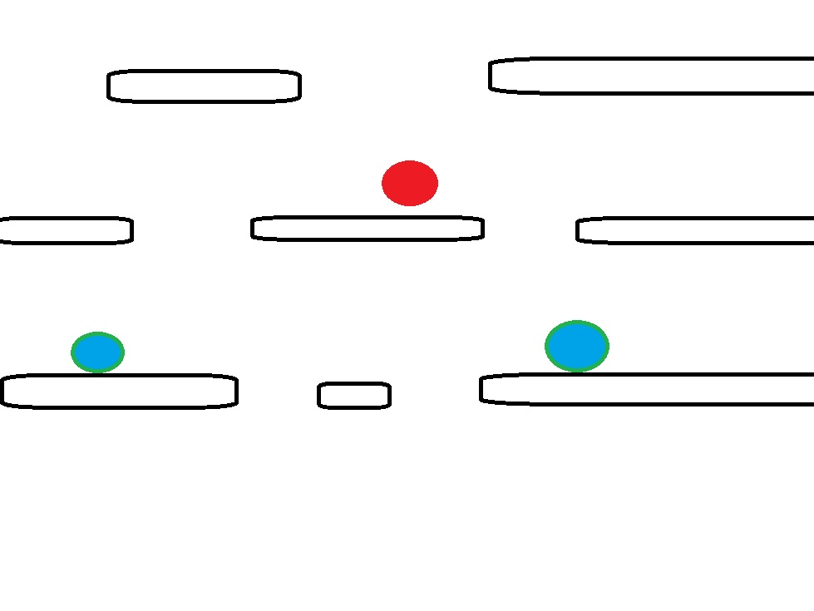
Triple Platform

Slide 11
For the player char.
The character has a given gun, used to kill the monsters.
The type of gun to be used is either constant, or selected right before the game
Shotgun, Rifle, Pistol
Shotgun has AoE, but lag time is high
Rifle has medium lag time, higher rate of fire (2 clips, 1 click)
Pistol has second to none lag time, but has second to none AoE too, fast motion

Slide 12
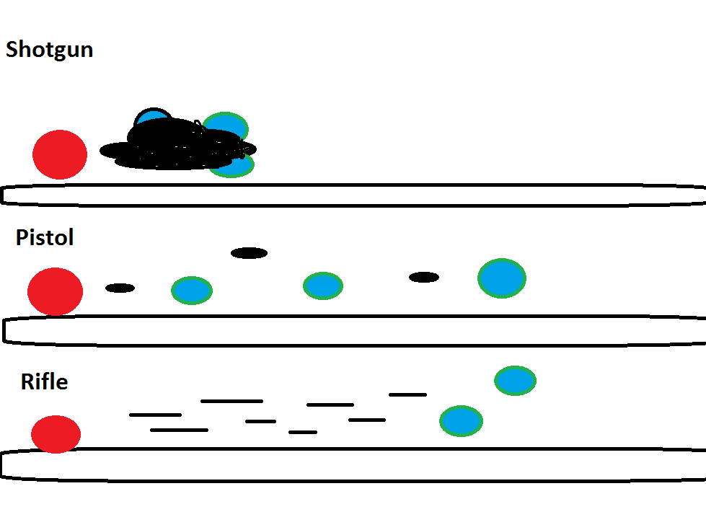
Basic Ammo

Slide 13
Lives
Sudden Death type, or Health Points type
Former: One collision and that’s it, game over
Latter: A number of lives are given (3 to 5)

Slide 14
Control
For endless runner, jump n’ shoot.
For bonus round, kill-em-all:
Full directional buttons, w/ jump/jumpdown n’ shoot(Dual/Tri platform)
Stationary at center, face left and right, shoot.(Single Platform)
Stationed to the end left, jump/jumpdown n’ shoot(good for both)
For bonus round, boss:
Same, except always facing right

Slide 15
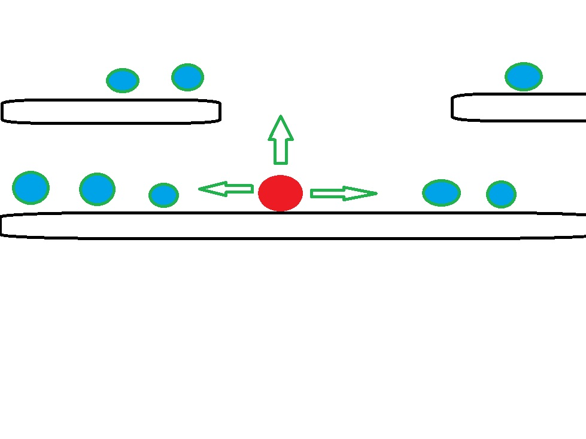
Full Control

Slide 16
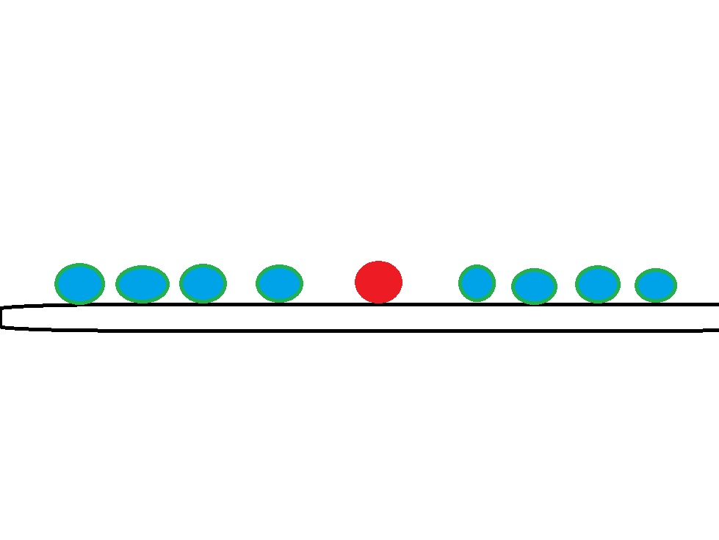
Centered

Slide 17
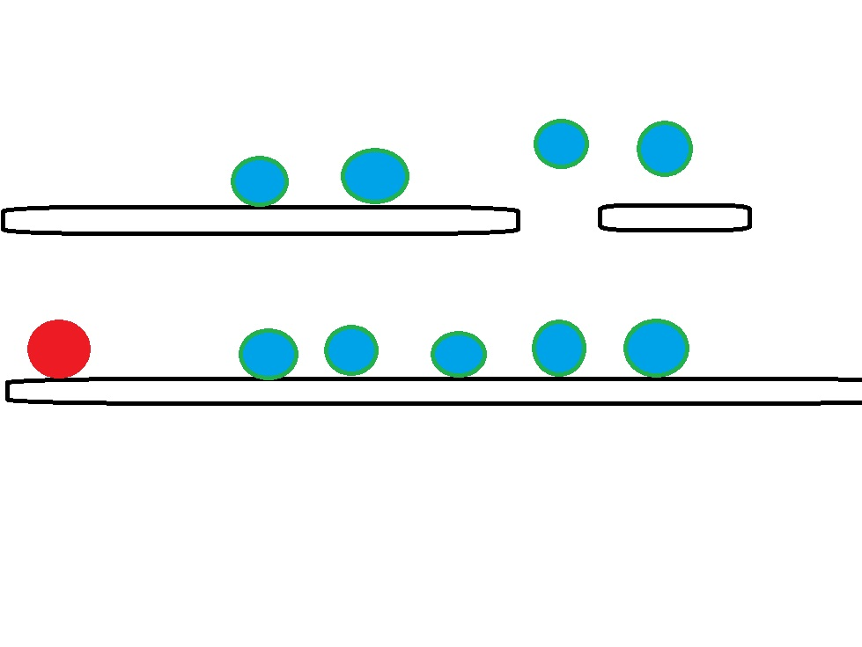
Stationed Left

Slide 18
Power-ups
Ammo/Gun-based powerup?
Stat based powerup?
Both?

Slide 19
Gun-based
Should the gun change every time too? Or just glow golden?
Ammunition-based or time-based limit?
Only one power up at a time
Picking up another will replace current one
Picking up the same powerup will reset its time limit

Slide 20
Ammunition-based
Ammunition-based limit essentially gives the player a number of rounds of a gun for the said powerup.
Up to the player to decide whether to save it up, not getting additional scores, or just use it, but may not catch up at the bonus round.
Notes:
Remaining rounds will appear above the avatar’s head

Slide 21
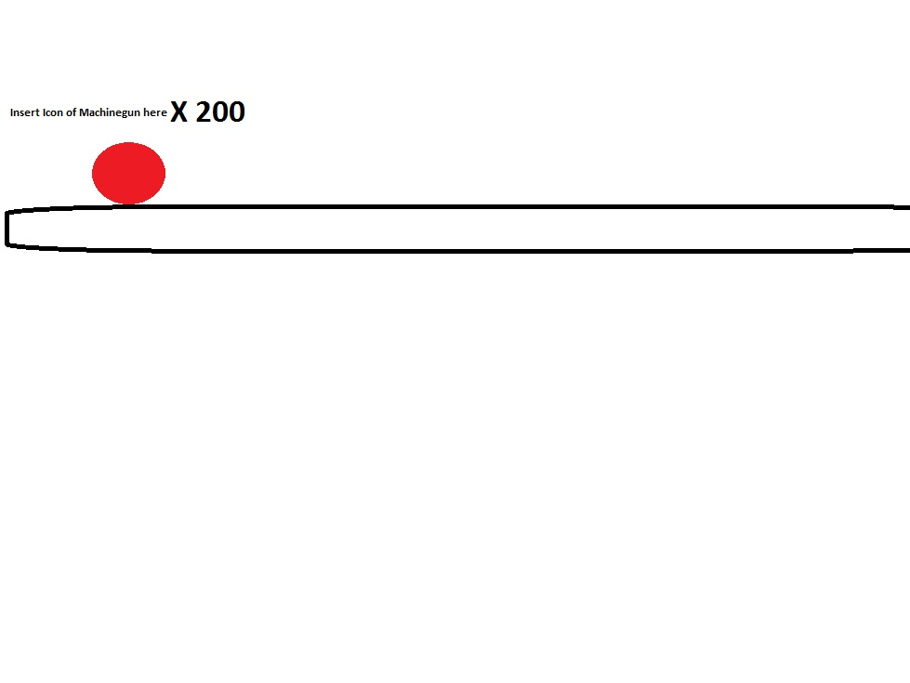
Ammo Based

Slide 22
Time-based
Limits the powerup to a certain amount of time
Denoted by a bar or a countdown
Overpowered in the extent of the bonus rounds. For the full limit, the player gets unlimited ammo, in a sense.

Slide 23
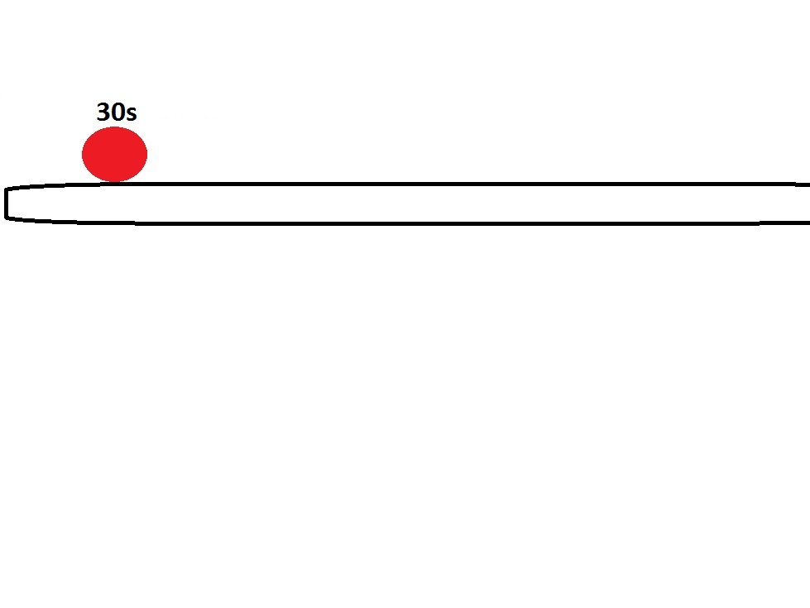
Time Based

Slide 24
Types of possible ammos
Most effective at Bonus Rounds :
Spreadshot(3/5-way)
Railgun (Straight Lightning Burst shot, goes through enemies)
Machinegun(Essentially Rifle with lower lag time and higher rate of fire)
Most effective for Endless Runner:
Double Barrel Shotgun - Higher AoE, less lag time
Sniper Rifle – Targets all in screen for a burst shot, a bit higher lag time
Magnum – mini AoE after hit/collsion, same lag time as pistol
Random ammo – next shot is different shot
Notes:
First three are good for the bonus rounds.
Last three are good for endless runner phases.

Slide 25
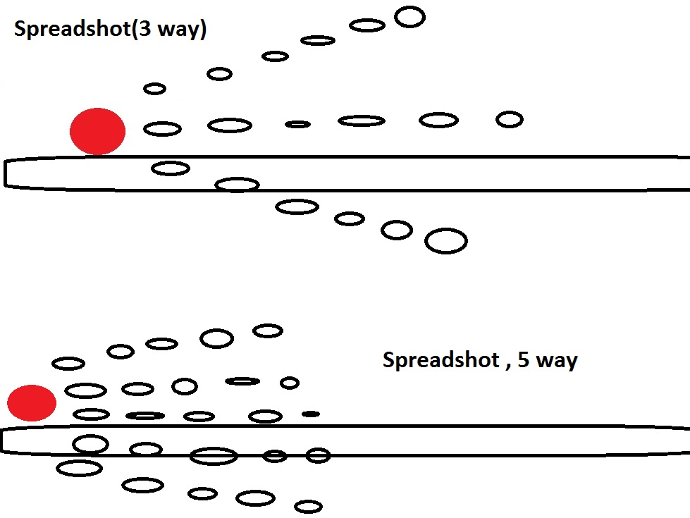
Spreadshots

Slide 26
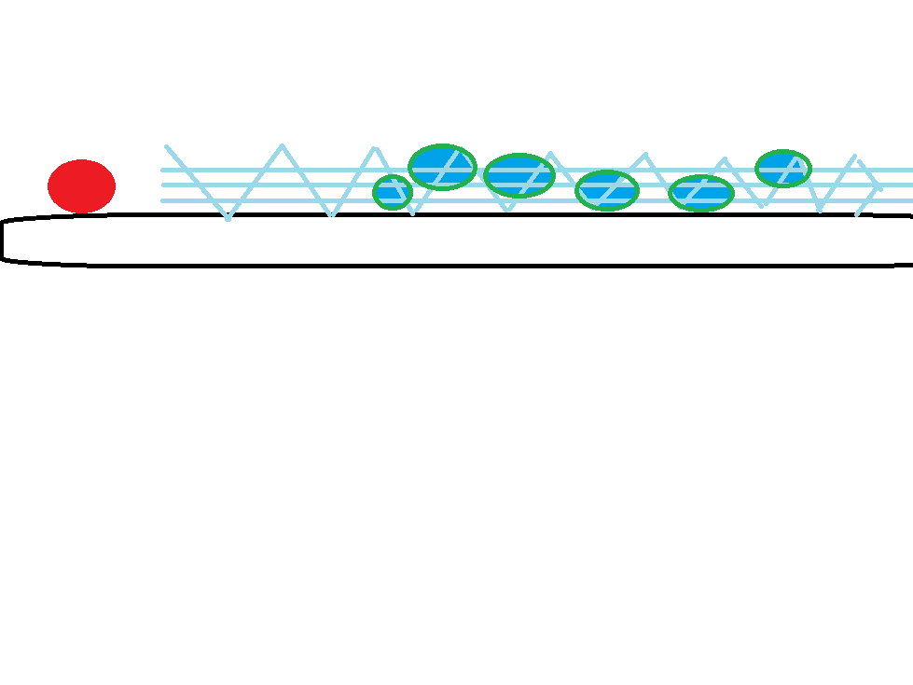
Railgun

Slide 27
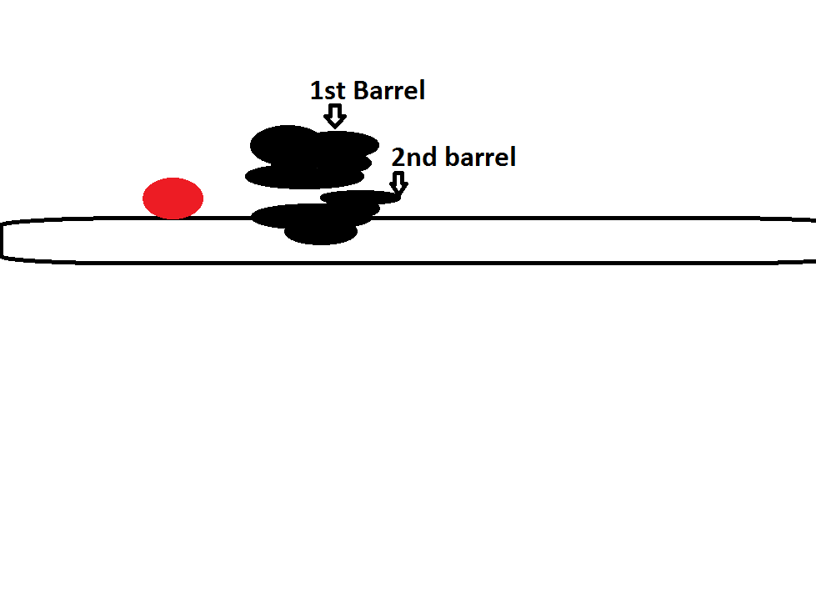
Double Barrel(2nd shot is either delayed or simultaneously fired)

Slide 28
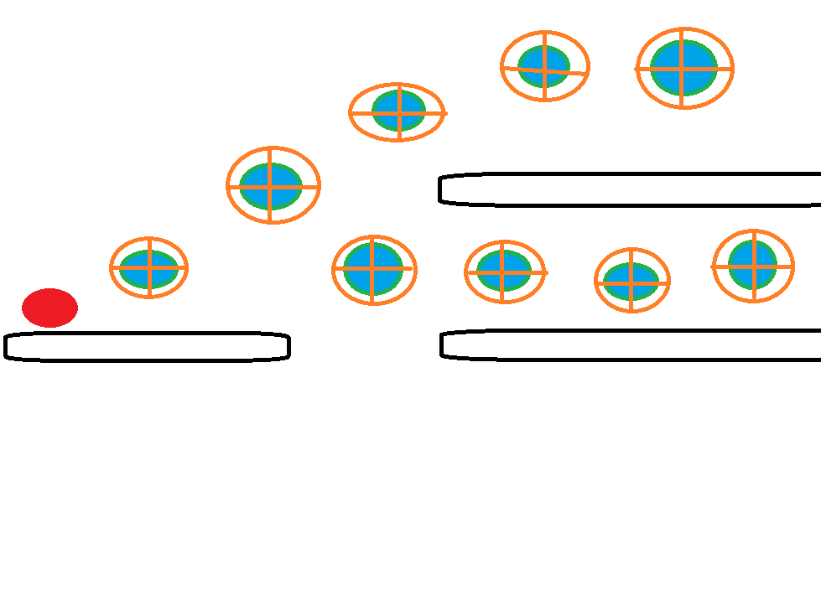
Sniper Rifle

Slide 29
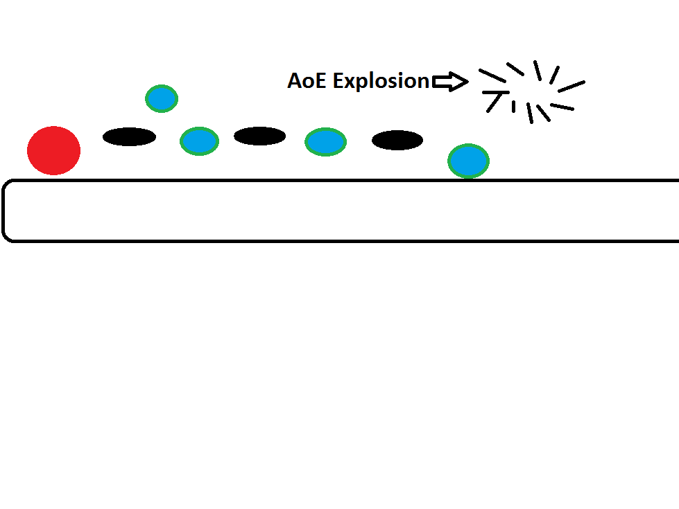
Magnum

Slide 30
Stat-based
Time-based
About the characters statistics instead.
Divided into utility and instant use types
Can have more than one
Utility types cannot be used at bonus rounds
Picking up the same utility powerup will reset its time limit

Slide 31
Utility
Invincibility – nothing can touch you
Gravity Orb – can control landing (needs another button for that though)
Spring shoes – higher jump height
Flame Armour – invincibility, but will kill anything hit; shorter time than invincibility
(2-3)Spinning Shurikens – kills anything it touches; has a wide gap, so still vulnerable

Slide 32
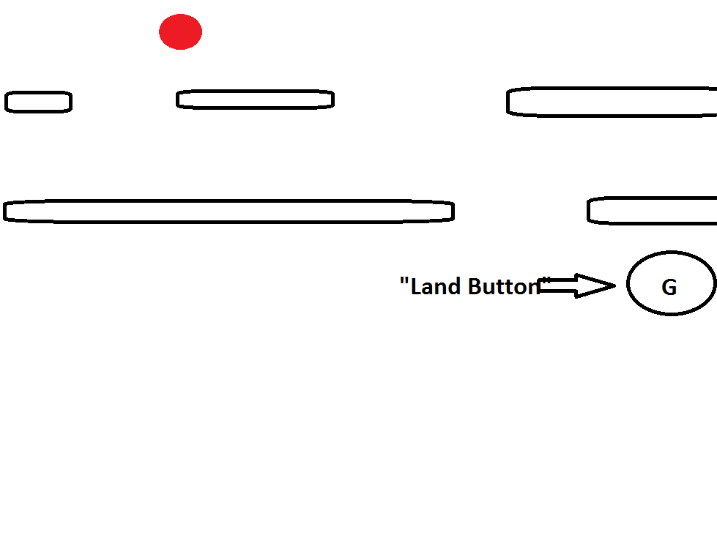
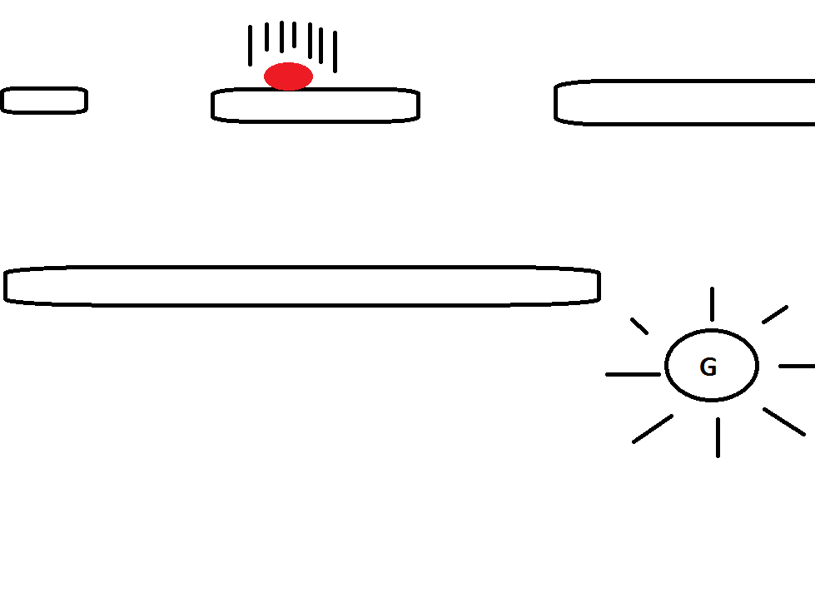
Gravity ORB

Slide 33
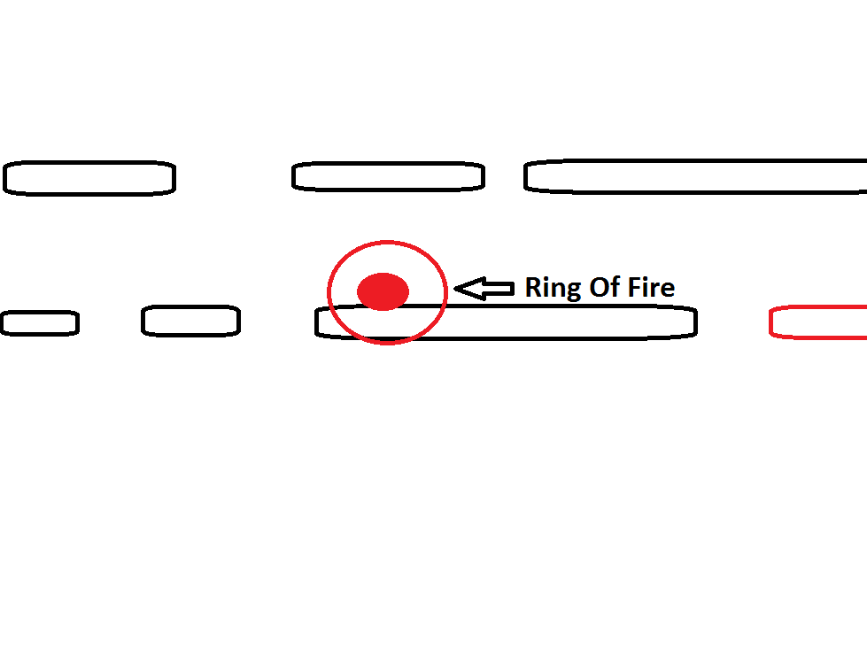
Flame Armour, Ring (otherwise, assume the character is burning )

Slide 34
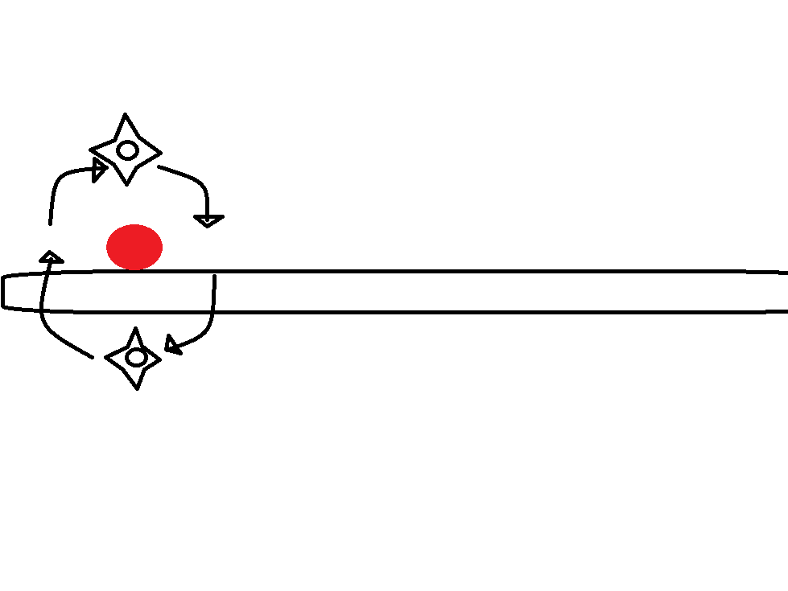
Shurikens -way

Slide 35
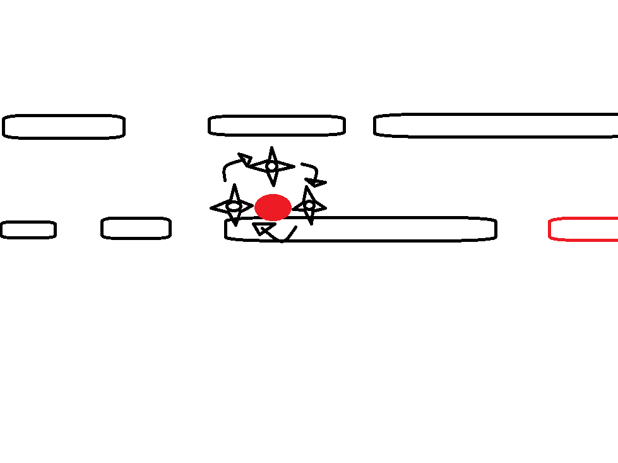
Shurikens, 3 way

Slide 36
Instant Use
Additional health point: self explanatory (iff health point system is implemented)
Monster Reborn Card Life Rope – instant revive after death(iff sudden death system is implemented)
Nuke – kills everything on screen
Whistle – call horses to stampede on monsters

Slide 37
Enemies!
Walker type – do nothing but stand
Pop-up type – will randomly pop-up from the ground
Jumping type – will jump at you (has a “tell”)
Flying enemies – in the air; more likely to carry other enemies and drop them; if killed, so is the enemy carried
Bomb enemies – explosions will make you jump automatically (can mess up player rhythm)
Notes:
Tell – warning signal
Bomb enemies will explode upon existence; a variation of the pop-up enemy, if you will.

Slide 38
Bonus round only enemies
Kamikaze enemy – goes toward you. Fast. (Only if not stationary style)
Pinata enemy – will spawn more enemies after passing a certain distance; if killed quickly, so does the enemies inside, and will also be counted to kill count
“Rare game” enemy – if killed, higher count is given (1 kill is 10 kill counts)
“Frenzy witch” enemy – if killed, kill count rate becomes higher for a very short period(for every kill, it is counted as two; say, if it was the same rare game enemy, 1 kill is 20 kill counts)
Notes:
“Frenzy Witch” kill becomes a buff

Slide 39
Boss attacks(skip if not to be implemented)
For dual/tri platform – platform by platform attacks
Instant death at one platform, so player must jump up/down
Slow moving ranged attack (missile, etc.)
Single platform
Projectile, hits on the platform/ground*
Can also roll on the ground, players must jump over it
Notes:
Better visualized for single platform

Slide 40
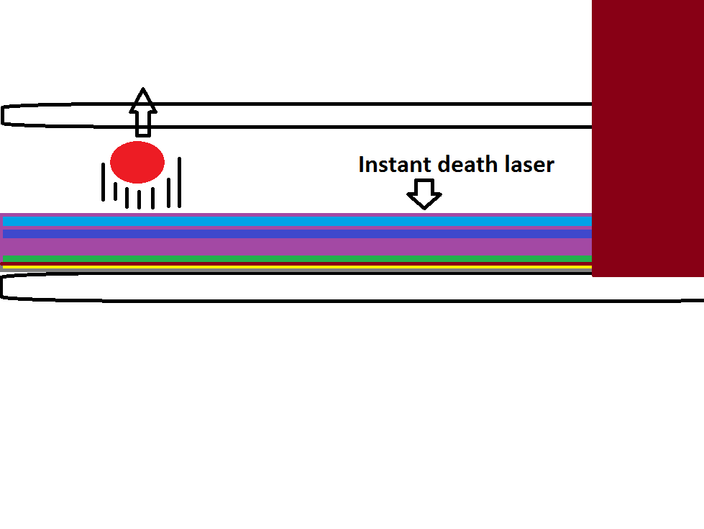
Instant death attack, one platform

Slide 41
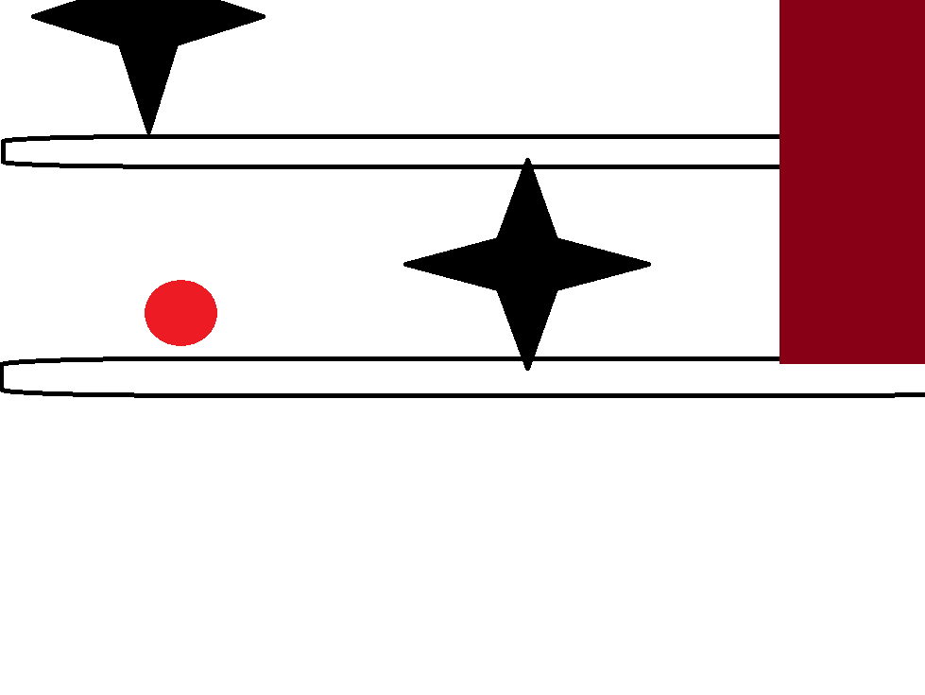
Slow Ranged Attack

Slide 42
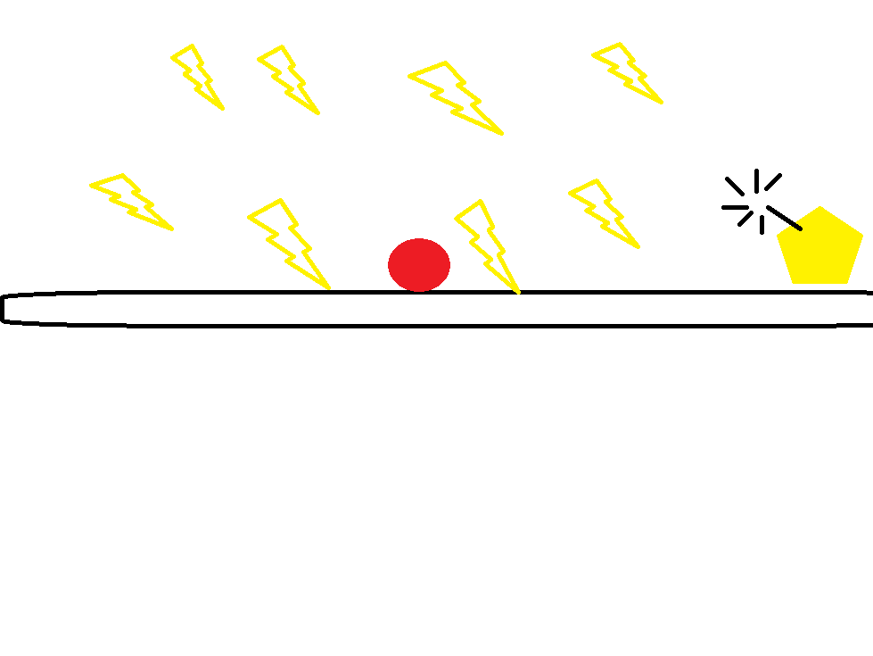
Projectile/Freefall

Slide 43
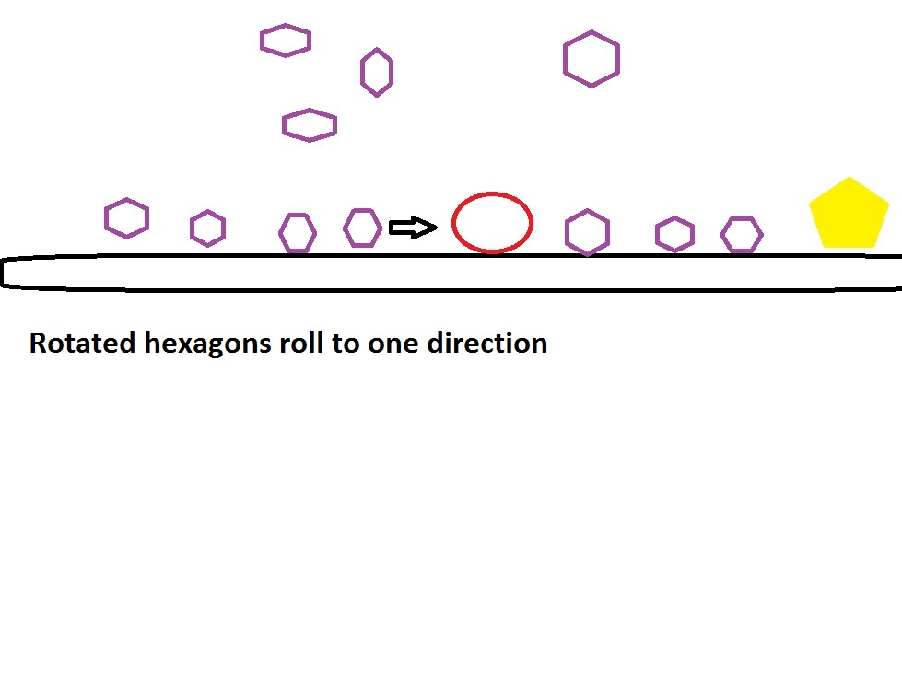
Rolling fallen projectiles

Slide 44
Theme
Cowboy/Secret Agent vs Aliens? Wild Wild West?
Criminal vs. S.W.A.T.? Modern world with buildings as platforms?
Laboratory themed? Protagonist as secret experiment?

Slide 45
So right now
The things here in the slides are for the core mechanics and bonus round mechanics, the player and enemy details might seem lacking.
Some of the ideas for the mechanics might not match/contradict the other ideas(like boss attacks/stationary bonus round)
If you have any more ideas, you could still comment them!

